Slide 1

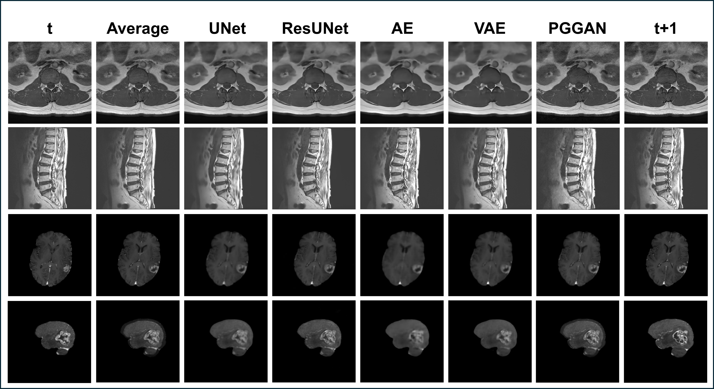
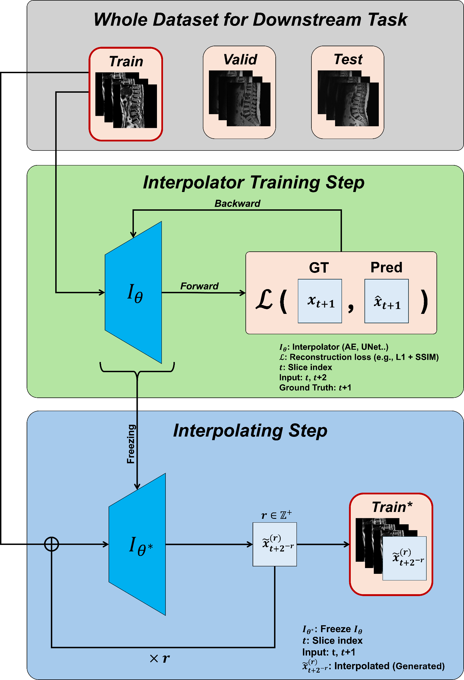
Inter-Slice MRI Interpolation for
Anatomy-Preserving Data Augmentation
2026 가톨릭대학교 데이터사이언스학과
성과 공유회
June Lee (Student ID: 202221759 )
Department of Data Science, The Catholic University of Korea, Bucheon, Republic of Korea
❖ (졸업) 성과공유회 포스터 제작 가이드라인 ❖
졸업대상자는 본인의 졸업 성과물(논문, 프로젝트)을 한장의 포스터로 정리한 후, 성과공유회에 전시합니다.
포스터는 A1사이즈로 출력했을 때, 글씨나 그림이 적절히 보이도록 구성하십시오.
프로젝트의 경우, 팀당 1개만 제작하면 됩니다.
상단의 연도는 본인의 졸업연도로 적으셔야합니다. (2025년 11월에 성과공유회를 하더라도, 졸업연도가 2026년2월이면 2026년으로 적음)
소제목(Introduction, Objective 등)은 변경가능합니다. 각박스의 사이즈도 변경 가능합니다. 그러나 전체적으로는 반드시 two columns 구조를 유지하십시오.
본 설명(빨간박스)은 삭제하고 제작하십시오.
Introduction
Results
Conventional augmentations (rotation/flip/crop) can distort clinically important anatomy, and irregular MRI inter-slice spacing weakens spatial continuity.
We propose an inter-slice interpolation–based augmentation that synthesizes anatomically consistent slices, preserving structure while expanding training diversity.
This anatomy-preserving strategy improves segmentation and detection performance without sacrificing clinical realism.
Objective
We develop an anatomy-preserving inter-slice MRI interpolation framework for efficient data augmentation.
Comparing simple averaging with lightweight models (AE, VAE, UNet, ResUNet, PGGAN), we synthesize anatomically consistent intermediate slices that boost segmentation/detection while maintaining structural fidelity at lower cost than Transformer-based methods.
Figure 2. Qualitative comparison of inter-slice MRI interpolation—Average, UNet, ResUNet, AE, VAE, and PGGAN—on spine (axial/sagittal) and brain, with t and t+1 indicating adjacent ground-truth slices.
Reconstruction (Table 1): UNet/ResUNet achieve the highest PSNR/SSIM across datasets (e.g., Spine-1 PSNR 25.08/24.90, SSIM 0.7902/0.7598; Brain PSNR 25.18/25.19, SSIM 0.7061/0.7062), while Average and PGGAN trail.
Downstream (Table 2): UNet yields the best overall performance (Spine-1 mAP@50 0.8329; Spine-2 DSC 0.8424 / mIoU 0.7407), and ResUNet leads Brain detection (mAP@50 0.5802, mAP@95 0.4059); all interpolation methods beat None, with Average < UNet/ResUNet.
Materials & Methods
Table 2. Downstream performance with different interpolators. Mean ± SD for detection (Spine-1, Brain) and segmentation (Spine-2) across runs.
Interpolator | Spine-1 |  | Spine-2 |  | Brain
 | PSNR | SSIM | PSNR | SSIM | PSNR | SSIM
Average | 21.35 | 0.6067 | 23.63 | 0.5900 | 24.34 | 0.6835
UNet | 25.08 | 0.7902 | 25.83 | 0.6801 | 25.18 | 0.7061
ResUNet | 24.90 | 0.7598 | 25.72 | 0.6769 | 25.19 | 0.7062
AE | 23.77 | 0.7592 | 24.97 | 0.6502 | 24.46 | 0.6906
VAE | 23.87 | 0.7401 | 24.88 | 0.6384 | 24.57 | 0.6901
PGGAN | 22.07 | 0.6998 | 23.91 | 0.5940 | 23.54 | 0.6704
Table 3. Downstream performance with different interpolators. Mean ± SD for detection (Spine-1, Brain) and segmentation (Spine-2) across runs.
Interpolator | Spine-1 |  | Spine-2 |  | Brain
 | mAP@50 | mAP@95 | DSC | mIoU | mAP@50 | mAP@95
None | 0.7247±0.0032 | 0.6164±0.0012 | 0.7953±0.0072 | 0.6794±0.0035 | 0.4939±0.0038 | 0.3643±0.0024
Baseline | 0.7862±0.0044 | 0.6344±0.0030 | 0.8097±0.0033 | 0.6915±0.0059 | 0.5447±0.0031 | 0.3894±0.0043
Average | 0.7847±0.0019 | 0.6220±0.0033 | 0.8287±0.0032 | 0.7198±0.0027 | 0.5458±0.0021 | 0.3844±0.0047
UNet | 0.8329±0.0043 | 0.6437±0.0036 | 0.8424±0.0028 | 0.7407±0.0046 | 0.5770±0.0035 | 0.3919±0.0012
ResUNet | 0.8074±0.0035 | 0.6378±0.0054 | 0.8421±0.0023 | 0.7406±0.0018 | 0.5802±0.0013 | 0.4059±0.0029
AE | 0.7962±0.0052 | 0.6367±0.0037 | 0.8314±0.0030 | 0.7205±0.0049 | 0.5528±0.0018 | 0.3778±0.0023
VAE | 0.7986±0.0012 | 0.6254±0.0020 | 0.8347±0.0029 | 0.7251±0.0025 | 0.5522±0.0027 | 0.3909±0.0042
PGGAN | 0.7963±0.0017 | 0.6375±0.0039 | 0.8312±0.0021 | 0.7190±0.0027 | 0.5728±0.0010 | 0.3894±0.0017
Ablation Study
R | Spine-1 |  | Spine-2 |  | Brain
 | mAP@50 | mAP@95 | DSC | mIoU | mAP@50 | mAP@95
1 | 0.8211 | 0.6397 | 0.8247 | 0.7139 | 0.5433 | 0.3778
2 | 0.8351 | 0.6427 | 0.8406 | 0.7340 | 0.5688 | 0.4001
3 | 0.8313 | 0.6413 | 0.8112 | 0.6922 | 0.5199 | 0.3556
Figure 1. Overall architecture
We first split the downstream dataset (train/val/test), then train an interpolator (AE/UNet ETC..) on slice triplets () -> using a reconstruction loss (L1+SSIM)
After training, we freeze and generate r-step inter-slice images only for the train split, producing anatomically consistent slice between adjacent indices.
The augmented train set is used to learn the downstream segmentation/detection models, while val/test remain untouched, ensuring gains come from interpolation-based augmentation rather than data leakage.
At r = 2, all tasks achieved their peak—Spine-1 mAP@50 = 0.8351; Spine-2 DSC = 0.8406 / mIoU = 0.7340; Brain mAP@50 = 0.5688—while r = 3 degraded performance.
Conclusions
Inter-slice MRI interpolation is an effective augmentation that preserves anatomical fidelity.
Among lightweight models, UNet/ResUNet delivered the best balance between reconstruction (PSNR/SSIM) and downstream performance (mAP/DSC/mIoU).
Improvements were largest in low-data settings—peaking at r = 2—and required no changes to downstream architectures or parameter counts.
Table 1. Datasets for downstream tasks
Dataset | Plane | MRI seq | Task | #Cls | Train (pt/img) | Val (pt/img) | Test (pt/img)
Spine-1 (VCF/Metz) | Sag | T1, T2 | Det. | 2 | 134 / 1,064 | 19 / 291 | 19 / 291
Spine-2 (Anatomy) | Ax | T1, T2 | Seg. | 7 | 16 / 1,560 | 2 / 184 | 2 / 164
Brain (Tumor) | Ax+Sag | T1w-CE | Det. | 1 | 121 / 500 | 14 / 50 | 39 / 145

